Slide 1
PLAN AND DEVELOP A PORTFOLIO WEBSITE
Adalat Jurat

Slide 2
Introduction
Hello everyone! My name is Adalat, and I'm delighted to be here today to present my portfolio website.
As a full-time mom and language teacher, I have a deep passion for education and teaching.
However, I noticed a lack of interactive language learning resources available for my students.
Motivated by this, I decided to embark on a journey to learn web design and development.
My goal is to create engaging and interactive language learning materials for my students to enhance their learning experience.
Through my portfolio website, I aim to showcase my progress in web design and demonstrate the potential of interactive educational website.
I'm excited to share with you the features and functionality of my portfolio website. Let's dive in!

Slide 3
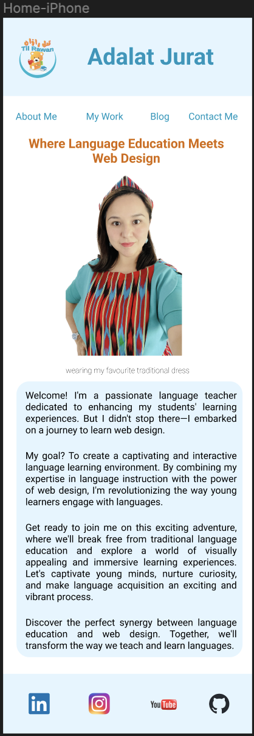
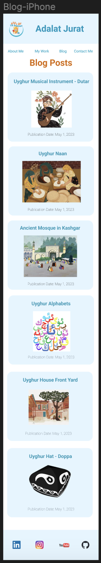
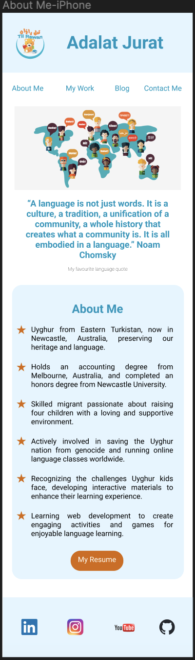
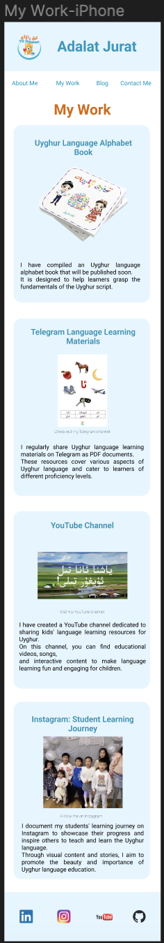
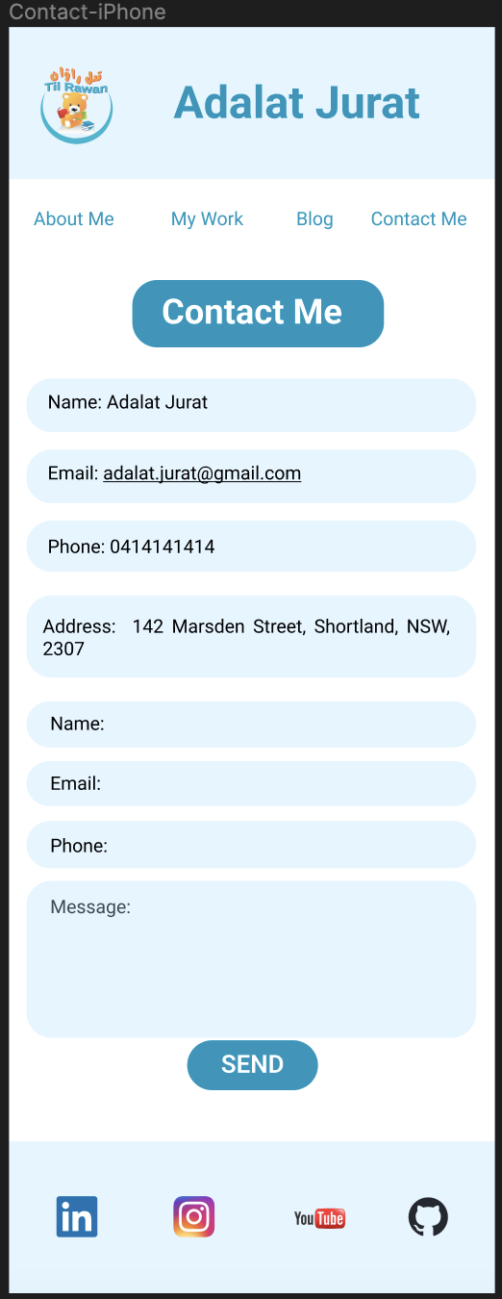
Walk-through of Portfolio Website
Now I want to take you for a visual walk-through of your portfolio website

Slide 4
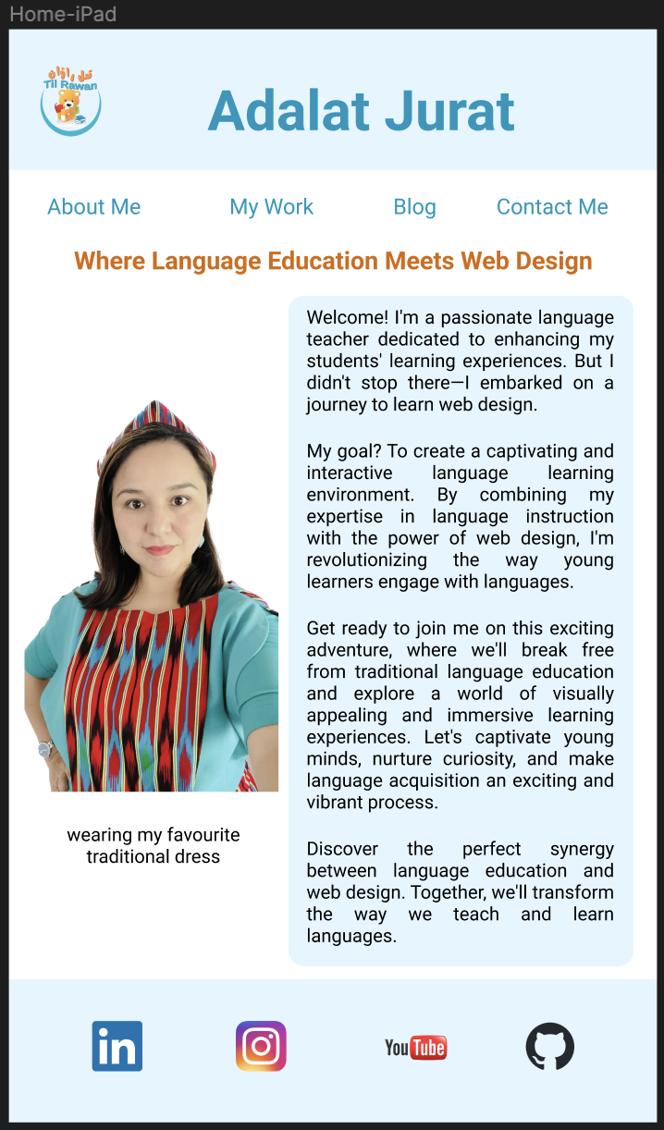
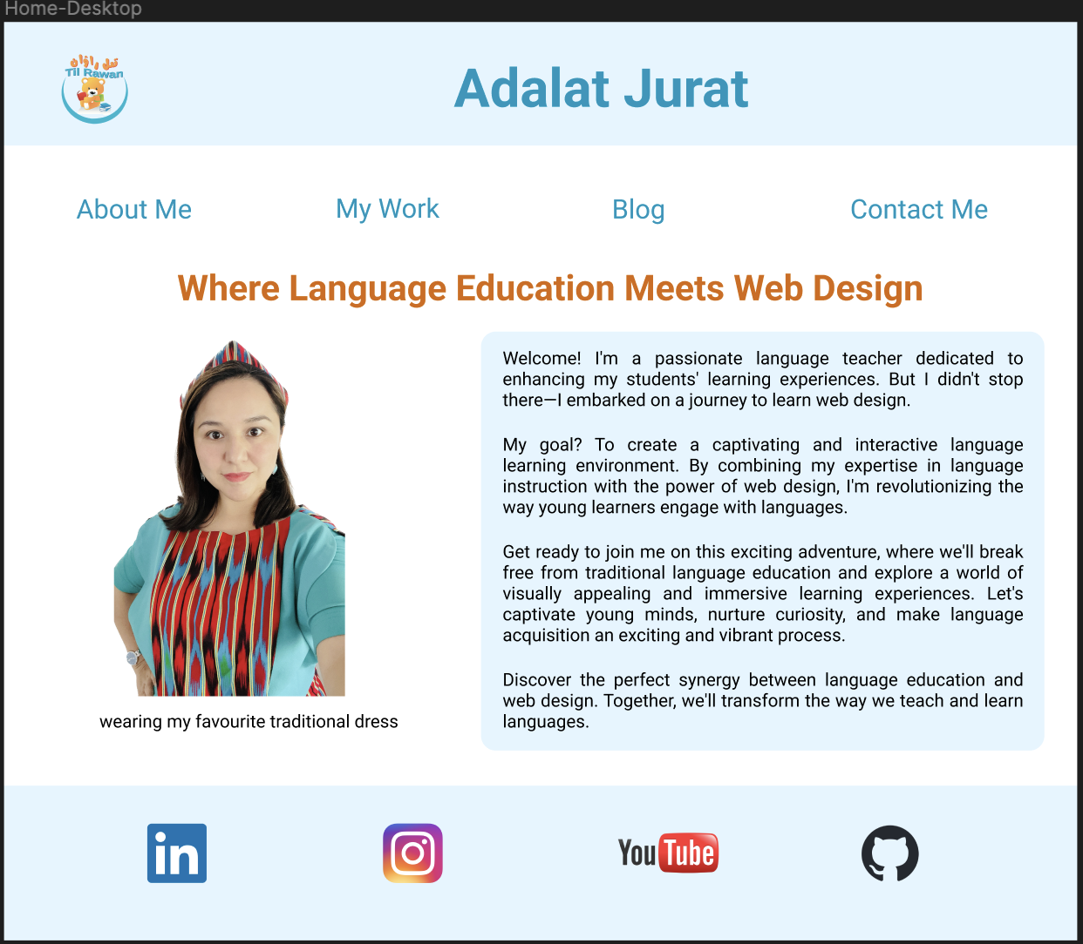
Walk-through of Portfolio Website
This is my Home page

Slide 5
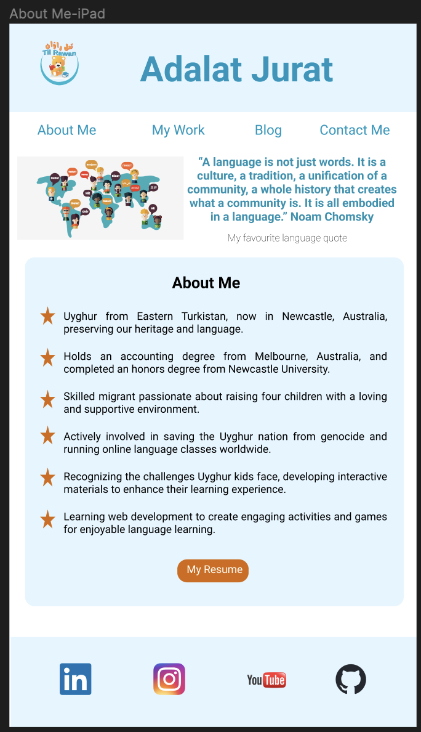
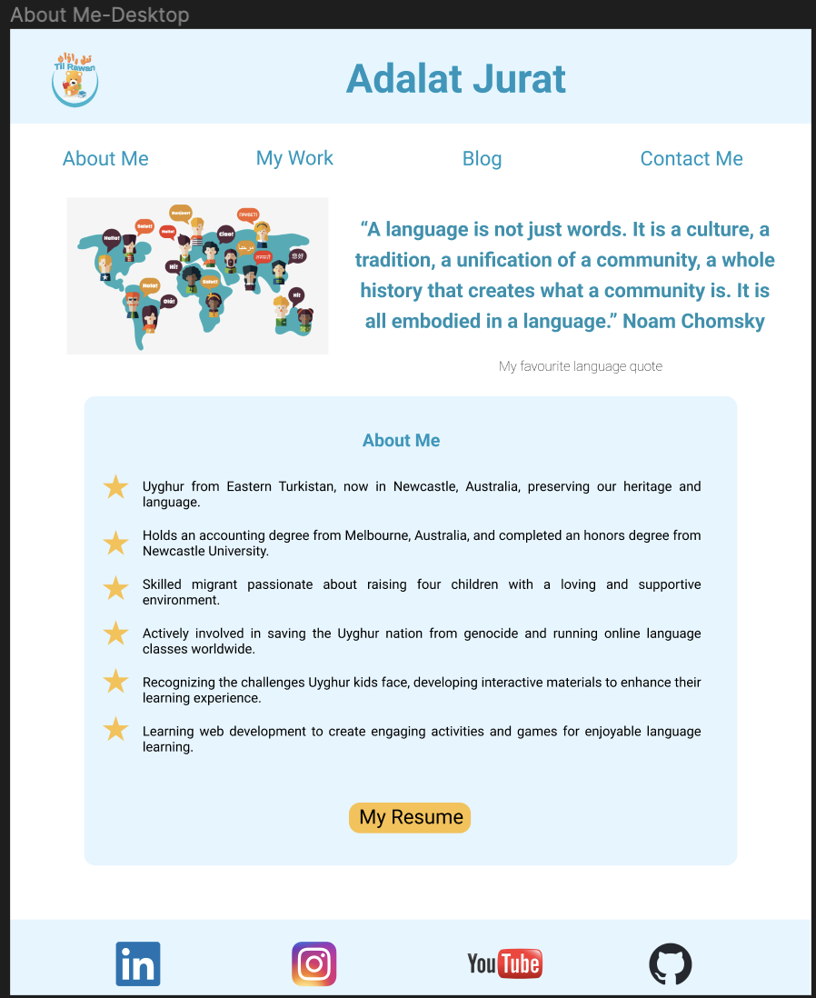
Walk-through of Portfolio Website
This is About Me page

Slide 6
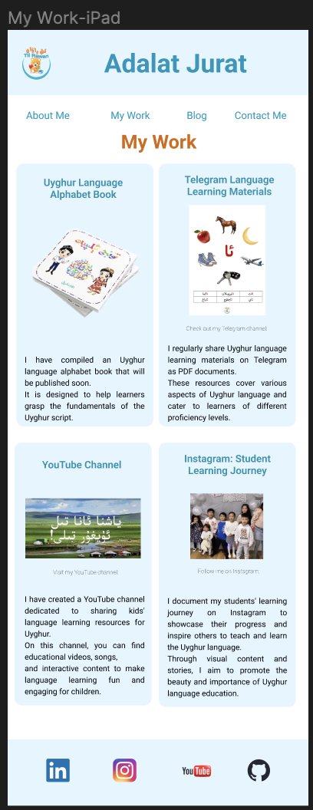
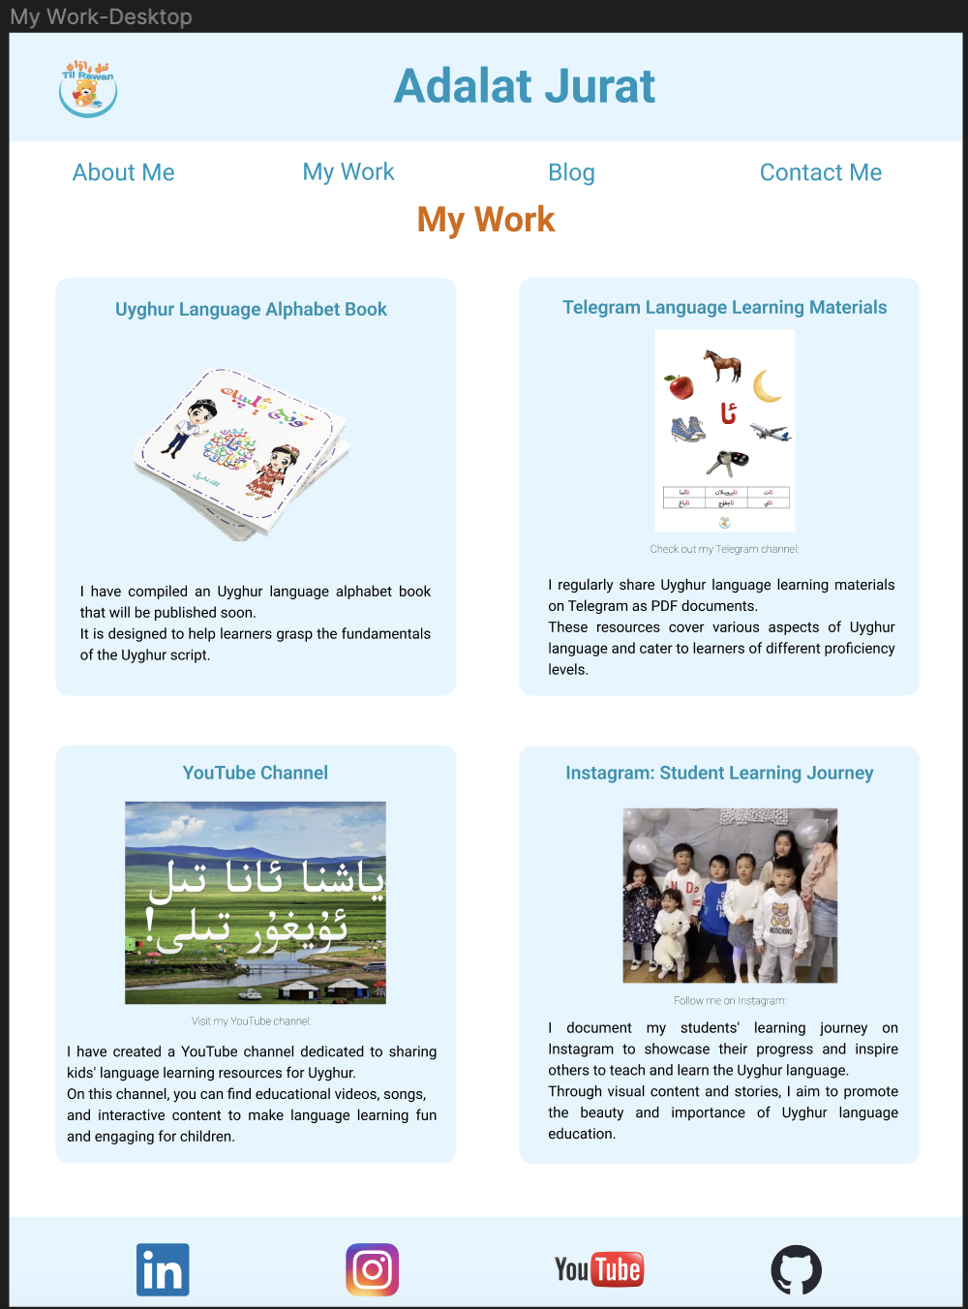
Walk-through of Portfolio Website
This is My Work page

Slide 7
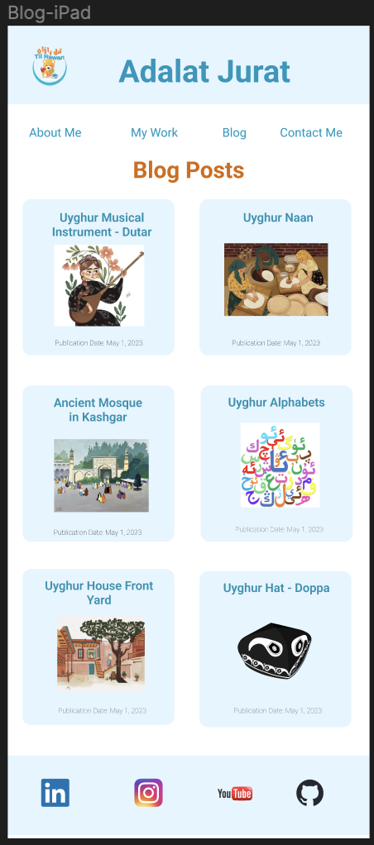
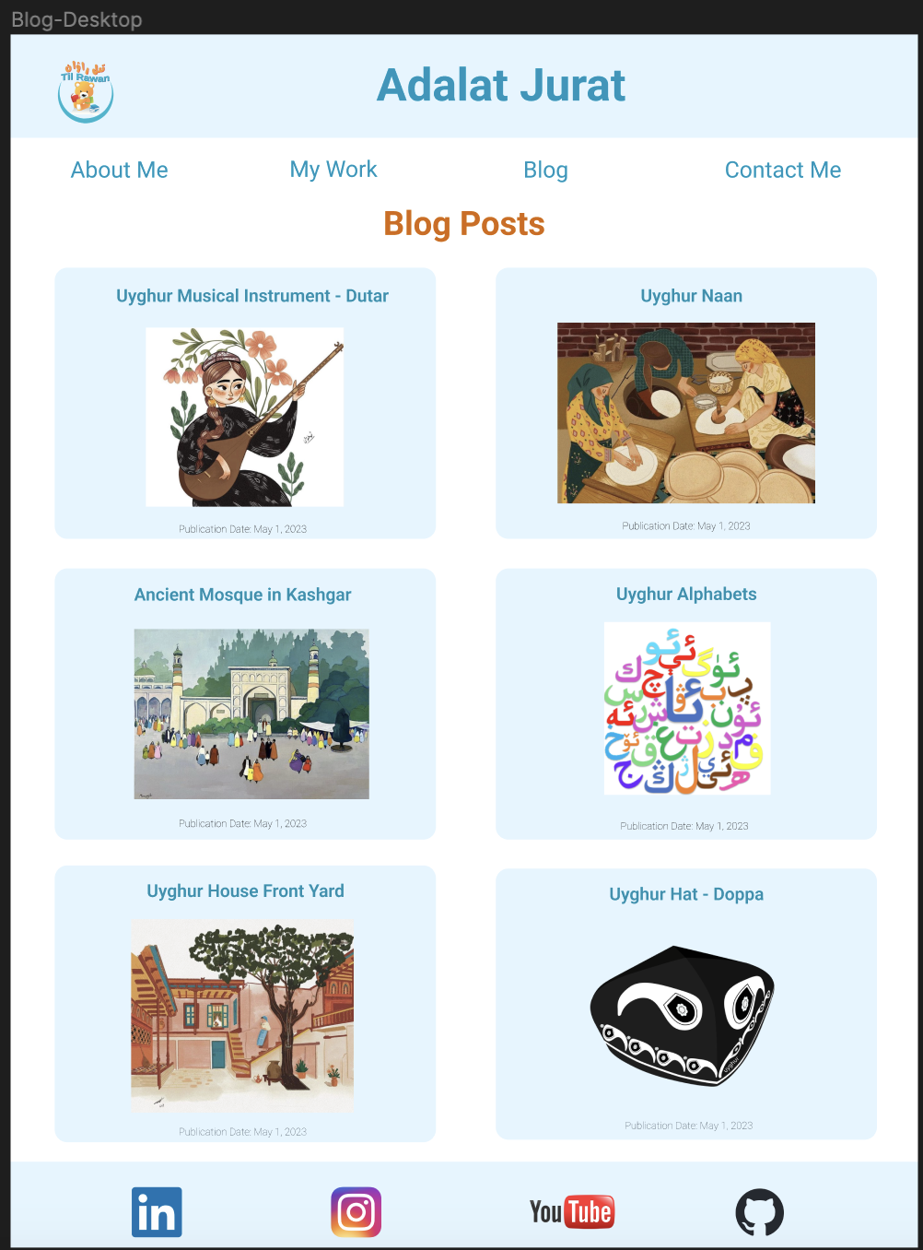
Walk-through of Portfolio Website
This is My Blog Posts page

Slide 8
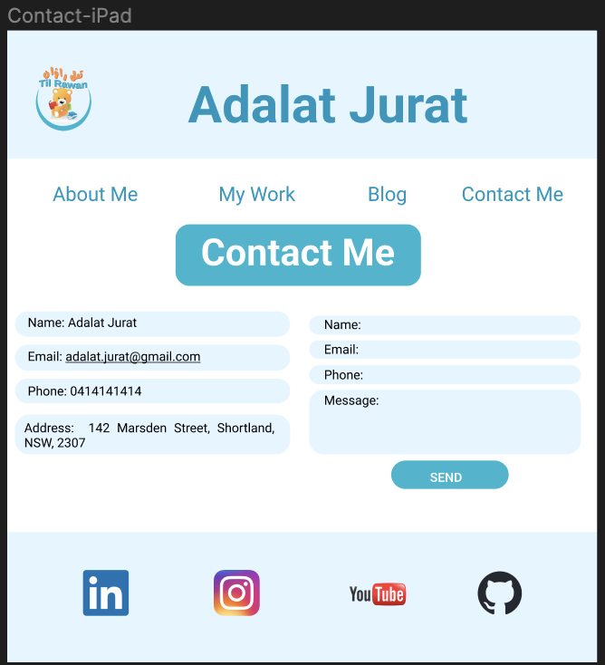
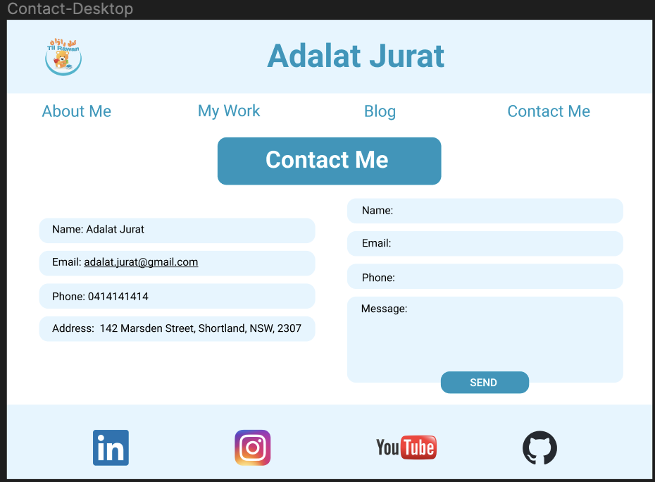
Walk-through of Portfolio Website
This is My Contact page

Slide 9
Development/Build Process
During my design process, I drew inspiration from the example shared by Akash during our Saturday's lesson. It provided a solid foundation for my website's layout and structure.
To create wireframes for my website, I initially used Balsamiq. However, I found that the lack of colors and the inability to insert real images hindered my creative process. As a result, I decided to switch to Figma, which allowed me to create wireframes with more visual elements and a realistic representation of my design.
By utilizing Figma, I was able to explore different design possibilities, experiment with colors, and incorporate actual images into my wireframes. This helped me visualize the final look and feel of my website more effectively.
Throughout the design process, I focused on ensuring a clean and user-friendly interface. I prioritized intuitive navigation, clear content organization, and a visually appealing aesthetic.
I also considered the responsive design aspect, aiming to create a website that seamlessly adapts to different screen sizes and devices. This mobile-first approach allowed me to prioritize the mobile experience while scaling up to tablet and desktop views.

Slide 10
Development/Build Process
To begin the development process, I started by creating the HTML pages based on the wireframes I designed. I started with the index.html page as the main entry point of my website.
Initially, I struggled with understanding how to properly use <div> containers and how to structure my HTML code. However, as I progressed and started styling my pages, I realized the importance of wrapping content within containers to apply consistent styles and layout across my website.
One of my favorite parts of the development process was encountering challenges and spending time exploring different solutions. There were moments where I found myself stuck on a particular issue, trying various approaches to resolve it.
Throughout the development process, I emphasized the importance of clean and readable code. I ensured meaningful comments were added where necessary, making it easier for me to understand and maintain the codebase.
In terms of styling, I adopted the Sass preprocessor to enhance my CSS workflow. By creating separate component files and importing them into a main.scss file, I achieved better organization and modularity.
As I progressed, I also adhered to the mobile-first approach, ensuring that my website was responsive and accessible across different devices. This involved testing and refining the design for tablet and desktop views, in addition to the initial focus on mobile devices.

Slide 11
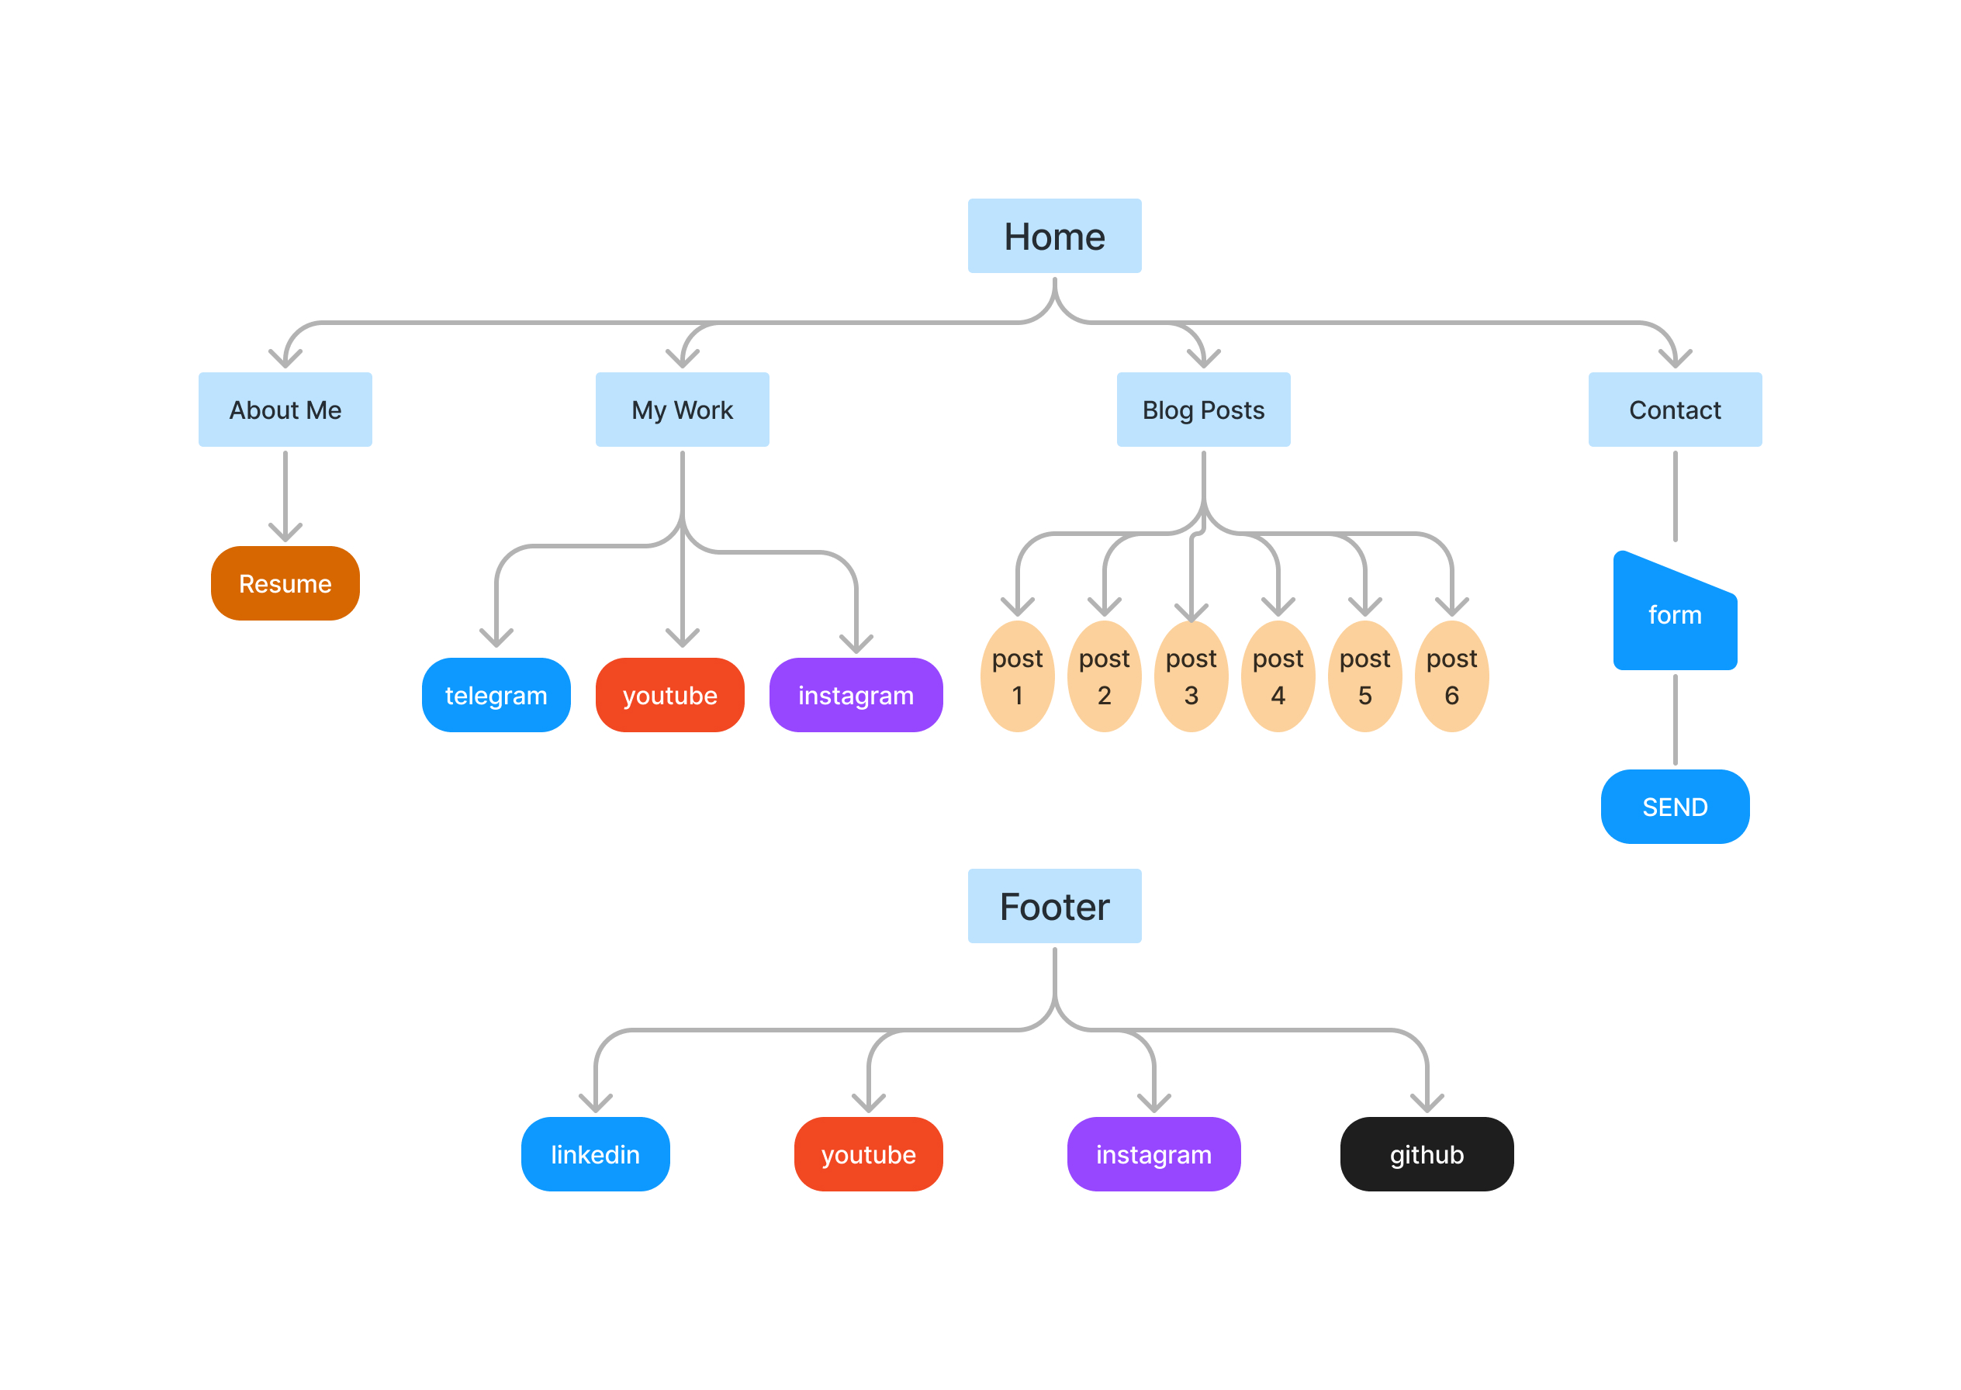
Sitemap
To ensure smooth navigation and organized content, I created a sitemap for my portfolio website using FigJam.
The sitemap illustrates the structure and hierarchy of my website, outlining the pages and their relationships.
Navigation: I have implemented a navigation bar that remains consistent across all pages. It allows users to easily access different sections of the website. The logo in the header bar acts as a link to the home page, ensuring quick navigation back to the main landing page.
Footer: The footer section, present on every page, provides links to my social media accounts, including Instagram, YouTube, LinkedIn, and GitHub. This allows visitors to connect with me on various platforms.

Slide 12
Future Steps and Conclusion
As the deadline approaches, I have encountered some issues with my codes and styling that I haven't had the opportunity to address fully. However, I acknowledge the importance of continuous improvement and learning in the web development journey.
Moving forward, I plan to dedicate more time to refining my codes and improving the overall styling of my website. This will involve seeking inspiration from experienced developers and watching tutorials on building complete websites.
In conclusion, although there are areas for improvement in my current portfolio website, I am proud of the progress I have made as a full-time mom and language teacher venturing into web design

